Slide 1


Job and Data Clustering for Aggregate Use of Multiple Production Cyberinfrastructures
Ketan Maheshwari, Allan Espinosa, Daniel S. Katz, Michael Wilde, Zhao Zhang, Ian Foster, Scott Callaghan, Phillip Maechling
Presenter: Daniel S. Katz
Senior Fellow, Computation Institute (University of Chicago & Argonne National Laboratory)
DIDC’12 (19 Jun 2012)

Slide 2
ExTENCI
Website: https://sites.google.com/site/extenci/
Joint Open Science Grid (OSG) and TeraGrid project
Funded by the National Science Foundation - Office of Cyberinfrastructure (OCI), Mathematics and Physics Directorate (MPS)
PIs: Paul Avery (University of Florida), Ralph Roskies (Pittsburgh Supercomputing Center), and Daniel S. Katz (University of Chicago).
Goal: Develop and provide production quality enhancements to the National Cyberinfrastructure that will enable specific science applications to more easily use both OSG and TeraGrid or broaden access to a capability to both TeraGrid and OSG users
Metric: We will have reached the goal if a science project makes production use of the new capability and/or there is a measured performance improvement or additional throughput of science application
Project rule: No Demos!
If it’s not a step towards production usage with the users involved, don’t do it

Slide 3
ExTENCI Subprojects
Technologies – Application/User – Leads (Sites)
Distributed File System (Lustre-WAN) – CMS/ATLAS HEP – Ralph Roskies & Paul Avery (PSC, U Florida)
Virtual Machines – STAR & CMS – Carol Song, Sebastian Goasguen, Todd Tannenbaum (Purdue, Clemson, Wisconsin)
Workflow & Client Tools – SCEC & Protein Folding – Daniel S. Katz, Mike Wilde (U Chicago)
Job Submission Paradigms – Cactus Application – Shantenu Jha (Rutgers)

Slide 4
Overview
Addressing the challenge of reducing the time-to-solution of the CyberShake earthquake simulation workflow
Goal: To reduce time-to-solution by optimally utilizing opportunistically obtained compute cores and wide-area data bandwidth on OSG and XSEDE production cyberinfrastructures
Approach: Clustering jobs and data into chunks suitable and favorable to the properties of each environment
Result: Achieved a sustained and balanced workload distribution of a large number of computations and large data using Swift and its Coasters framework
Representative of a generalized solution to seamlessly access diverse resources in a single high-level run

Slide 5
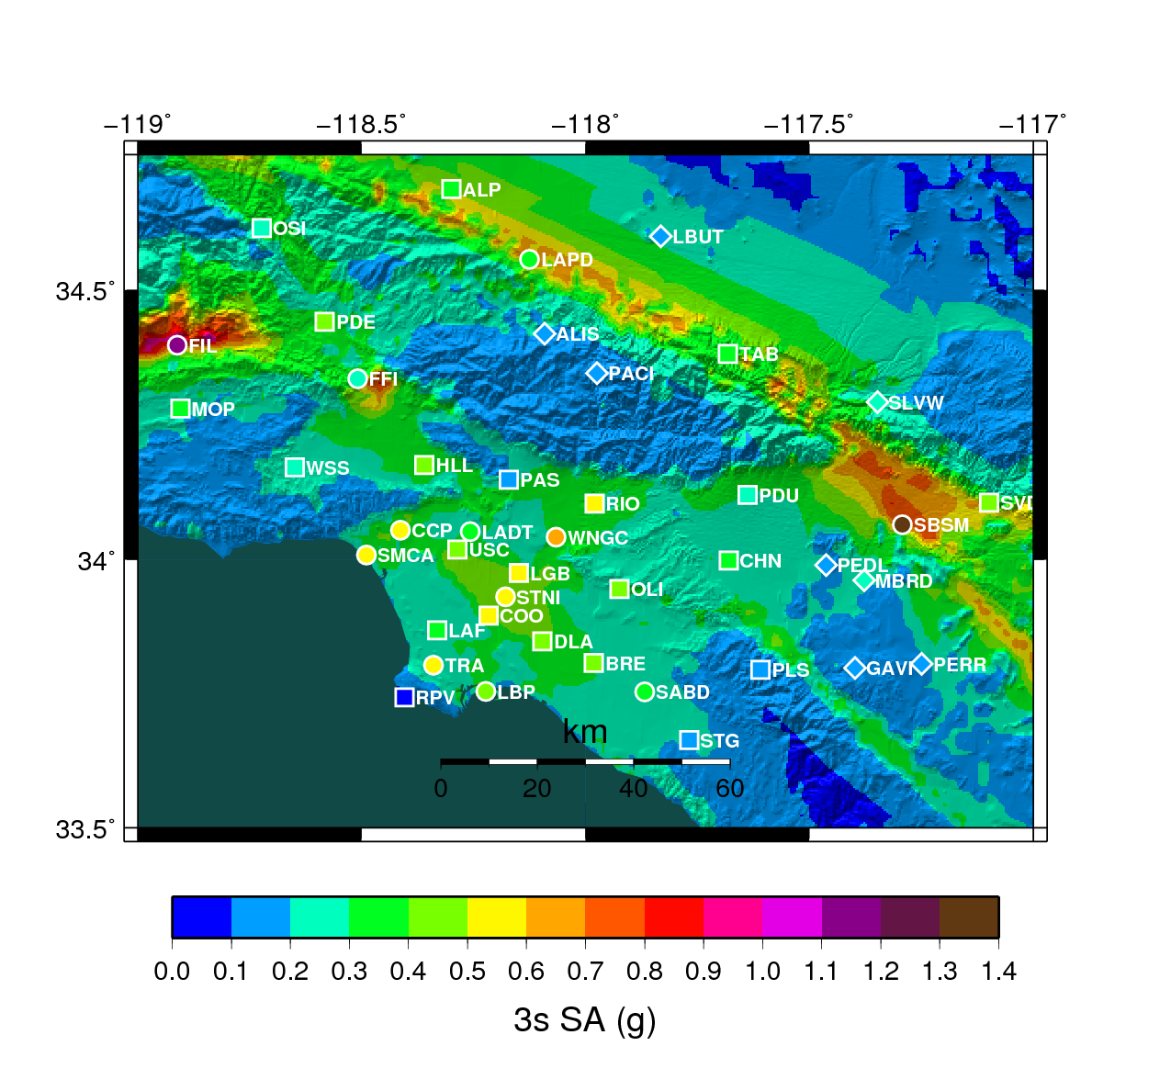
SCEC CyberShake
Part of SCEC (PI: Tom Jordan, USC)
Using large scale simulation data, estimate probabilistic seismic hazard (PSHA) curves for sites in southern California (probability that ground motion will exceed some threshold over a given time period)
Used by hospitals, power plants, schools, etc. as part of their risk assessment
Based on Rupture Variations (RupVar) set
~14,000 Potential ruptures, with likelihood derived from earthquake rupture forecast (ERF)
Use cases:
Build map of area (run 1k-10k locations) based on latest RupVarset
Run one location, based on latest RupVar set
(~270 locations run to-date by SCEC, all on USC or TG)
Image courtesy of Philip Maechling
Managing these requires effective grid workflow tools for job submission, data management and error recovery.
Currently running production on TG using Pegasus (ISI) and DAGman (Wisconsin).

Slide 6
SCEC CyberShake
For each location
SGT: a pair of MPI runs (~400 cores, ~10 hours)
PP: ~840,000 parallel short jobs (420,000 synthetic seismograms, 420,000 extractions of peak ground motion)
Rupture Variation (RupVar) dataset
~14,000 Potential ruptures, with likelihood derived from earthquake rupture forecast (ERF)
~7000 will affect any one site
2-1000 variations (45 average) per rupture, all equally likely (~600k rupture variations total)
Data size: ~2 TB total
146 MB per rupture (average)
~3 MB per rupture variation (average)

Slide 7
SGT Data Flow

Slide 8
Postprocessing Data Flow

Slide 9
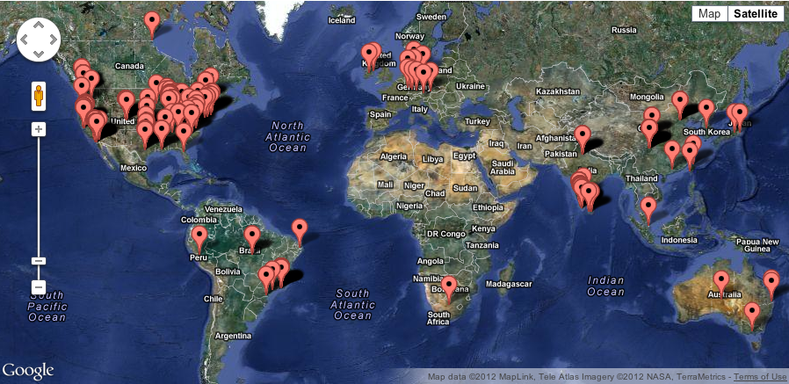
Swift
Idea: use Swift instead of Pegasus/DAGman
To get more control; Pegasus/DAGman is a black box, but we can change Swift as needed
Swift is a parallel scripting language/system
Use Coasters multi-level scheduling (Swift’s pilot job mechanism)
We can opportunistically acquire about 2000 CPUs on OSG in a few hours
Swift handles backend operation
Can move files to/from and launch jobs on TG, OSG, etc.
Swift - http://www.ci.uchicago.edu/swift

Slide 10
Straightforward Swift implementation
Site site = "LGU";
Sgt sgt<"From MPI code
computed in TeraGrid">;
Rupture rups[]=get_rupture(sgt);
foreach rup in rups {
Sgt sub;
sub = extract(sgt, rup);
Variations vars = get_variations(site, rup);
Seismogram seis[];
PeakValue peak[];
foreach var,i in vars {
seis[i] = seismogram(sub, var);
peak[i] = peak_calc(seis[i], var);
} // end foreach over vars
} // end foreach over rups

Slide 11
Problems with straightforward code
Can’t keep data on OSG sites
Need full 2 TB on each site to use that site, because Swift doesn’t currently have a good data-affinity-aware scheduling mechanism, and because OSG resources are opportunistic
So, need to move data to where resources are available
Basically – move 40 GB for each rupture, extract 160 MB for that rupture, move 3 MB for each rupture variation, make calculations associated with the variations
But, data movement times overwhelmed compute times (when trying to do this at 2000x parallel)
So, be more clever in scheduling
With the idea that this could be automated in Swift later

Slide 12
Analysis
The extract stage needs 40G of data to run; impractical on remote resources such as OSG
Data intensive jobs best scheduled on XSEDE resources hosting large amount of SGT and rupvar data
Small seispeak jobs must be clustered to conserve bandwidth and utilize resources; clustering size must be directly proportional to the optimal walltime on OSG site
Sufficient shared-space available on OSG sites to host clustered data

Slide 13
Current solution
Combine everything into a single Swift script
Do SGT on TeraGrid
Split PP across TG and OSG, based on # of rupture variations per rupture
Do all SGT extractions on TG (rather move 160 MB subSGTs than 40 GB SGTs) – reduces overall data movement dramatically
<20: do work on TG
No data transfer needed, reduced total data transfer by ~50%
>20, <60: send a bundle of work to an OSG CPU
Limited subSGT data transfer, minimal RupVar transfers, reasonable work/transfer (1-4 hrs)
>60: divide into bundles of ~60 variations
Still have limited subSGT data transfer, minimal RupVar transfers, reasonable work/transfer (~4 hrs)
Some redundant subSGT data transfer (~20%)

Slide 14
Performance on OSG and XSEDE
255+ active parallel jobs on XSEDE Ranger
2000+ CPUs acquired on OSG Resources

Slide 15
SGT Data Flow

Slide 16
Conclusions
Addressing the diverse model of computation on different cyberinfrastructures a challenge
Data hungry processes pose a special challenge: solution must be planned around data movement costs and requirements
Solution is mostly generic
Could be applied to other applications
Could be applied to cloud resources
Notes:
Collaborations?

Slide 17
Acknowledgements
This research was funded in part by NSF under ExTENCI (grant OCI-1007115), by NSF through TeraGrid/XSEDE resources provided by TACC under grant TG-ASC090068, and by the US Department of Energy under contract DE-AC02- 06CH11357
It also used Open Science Grid resources supported by diverse sources, including DOE and NSF

Slide 18

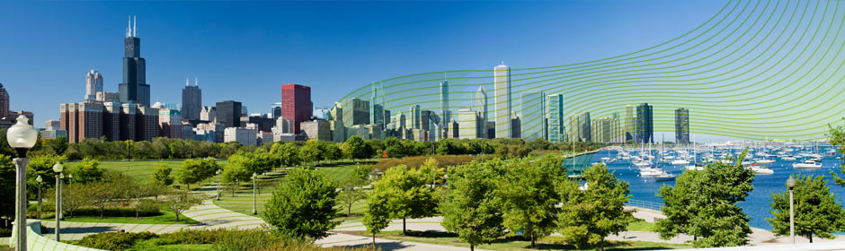
8-12 October 2012 Chicago, IL, USA
http://www.ci.uchicago.edu/escience2012/
eScience Conference main events Wednesday – Friday
(keynotes, papers, panels, posters)
Paper submissions due 11 July; posters, 24 Aug
Microsoft eScience Workshop Monday – Tuesday
Additional eScience workshops Monday – Tuesday
Open Grid Forum OGF36 Monday – Wednesday
GLIF Annual Meeting Thursday – Friday
Conference Tracks:
eScience Algorithms and Applications
• eScience application areas, including:
• Physical sciences
• Biomedical sciences
• Social sciences and humanities
• Data-oriented approaches and applications
• Compute-oriented approaches and applications
• Extreme scale approaches and applications
Cyberinfrastructure to support eScience
• Novel hardware
• Novel uses of production infrastructure
• Software and services
• Tools
General Chair Ian Foster
Program Co-Chairs Daniel S. Katz, Heinz Stockinger
Program Vice Co-Chairs David Abramson, Gabrielle Allen, Rosa M. Badia, Geoffrey Fox
Early Results and Works-in-Progress Posters Chair Roger Barga
Workshops Chair Ruth Pordes
Sponsorship Chair Charlie Catlett
Conference Manager and Finance Chair Julie Wulf-Knoerzer
Publicity Chairs Kento Aida, Ioan Raicu, David Wallom

